Slide 1
Module 5
Java EE Web Applications

Slide 2
Content to be discussed
Introduction to Eclipse & Apache Tomcat Server
Servlet API Fundamentals
ServletContext
Session
Cookies
Request Redirection Techniques

Slide 3
Web Browser
a program which acts as an interface between user and web application e.g. Internet Explorer, Chrome, Safari, Mozilla firefox etc.
What is a web application?
A web application is an application accessible from the web.
A web application is composed of web components like Servlet, JSP, Filter, etc. and other elements such as HTML, CSS and JavaScript.
The web components typically execute in Web Server and respond to the HTTP request.

Slide 4
Web Server
A web server is a software application or hardware device that stores, processes, and serves web content to users over the Internet. It plays a critical role in the client-server model of the World Wide Web, where clients (typically web browsers) request web pages and resources, and servers respond to these requests by delivering the requested content.
Web servers operate on the Hypertext Transfer Protocol (HTTP), which is the foundation of data communication on the World Wide Web. When you enter a website’s URL into your browser, it sends an HTTP request to the web server hosting that website, which then sends back the web page you requested, allowing you to view it in your browser.

Slide 5
Eclipse & Apache Tomcat Server
For Web & EE app development the requirement is “Eclipse IDE for Enterprise Java and Web Developers”
Apache Tomcat is a web server and servlet container that's used to deploy and serve Java web applications.
Install Tomcat on Windows - https://tomcat.apache.org/download-90.cgi
Install

Slide 6
Servlet
Servlet technology is used to create a web application (resides at server side and generates a dynamic web page).
Servlet is an API that provides many interfaces and classes including documentation.
Servlet is an interface that must be implemented for creating any Servlet.
Servlet is a class that extends the capabilities of the servers and responds to the incoming requests.
Servlet is a web component that is deployed on the server to create a dynamic web page.
Servlet technology is robust and scalable because of Java language.
Before Servlet, CGI (Common Gateway Interface) scripting language was common as a server-side programming language.
There are many interfaces and classes in the Servlet API such as Servlet, GenericServlet, HttpServlet, ServletRequest, ServletResponse, etc.

Slide 7
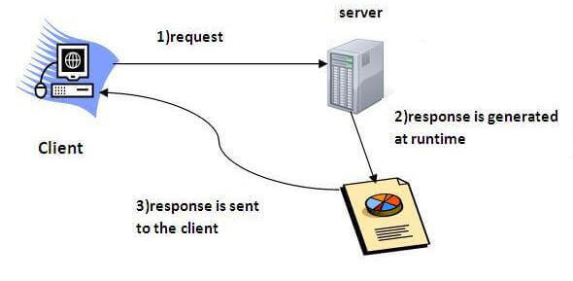
How servlet operates?

Slide 8
Advantages of Servlet
The advantages of Servlet are as follows:
Better performance: because it creates a thread for each request, not process.
Portability: because it uses Java language.
Robust: JVM manages Servlets, so we don't need to worry about the memory leak, garbage collection, etc.
Secure: because it uses Java language.

Slide 9
HTTP request methods
The HTTP request method indicates the method to be performed on the resource identified by the Requested URI (Uniform Resource Identifier). This method is case-sensitive and should be used in uppercase.
HTTP Request | Description
GET | Asks to get the resource at the requested URL.
POST | Asks the server to accept the body info attached. It is like GET request with extra info sent with the request.
HEAD | Asks for only the header part of whatever a GET would return. Just like GET but with no body.
TRACE | Asks for the loopback of the request message, for testing or troubleshooting.
PUT | Says to put the enclosed info (the body) at the requested URL.
DELETE | Says to delete the resource at the requested URL.
OPTIONS | Asks for a list of the HTTP methods to which the thing at the request URL can respond

Slide 10
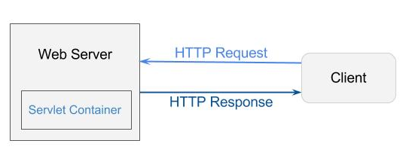
Servlet Container
It provides the runtime environment for JavaEE (J2EE) applications. If the user wants to read the web pages as per input, then the servlet container is used in java.

Slide 11
Servlet Container States
The servlet container is the part of web server which can be run in a separate process. We can classify the servlet container states in three types:
Standalone: It is typical Java-based servers in which the servlet container and the web servers are the integral part of a single program.
For example:- Tomcat running by itself.
In-process: It is separated from the web server, because a different program runs within the address space of the main server as a plug-in.
For example:- Tomcat running inside the JBoss.
Out-of-process: The web server and servlet container are different programs which are run in a different process. For performing the communications between them, web server uses the plug-in provided by the servlet container.

Slide 12
Servlet API
The javax.servlet and javax.servlet.http packages represent interfaces and classes for servlet api.
The javax.servlet package contains many interfaces and classes that are used by the servlet or web container. These are not specific to any protocol.
The javax.servlet.http package contains interfaces and classes that are responsible for http requests only.

Slide 13
Servlet Interface
Servlet interface provides common behavior to all the servlets. Servlet interface defines methods that all servlets must implement.
Servlet interface needs to be implemented for creating any servlet (either directly or indirectly).
It provides 3 life cycle methods that are used to initialize the servlet, to service the requests, and to destroy the servlet and 2 non-life cycle methods.

Slide 14
Methods of Servlet interface
Method | Description
public void init(ServletConfig config) | initializes the servlet. It is the life cycle method of servlet and invoked by the web container only once.
public void service(ServletRequest request, ServletResponse response) | provides response for the incoming request. It is invoked at each request by the web container.
public void destroy() | is invoked only once and indicates that servlet is being destroyed.
public ServletConfig getServletConfig() | returns the object of ServletConfig.
public String getServletInfo() | returns information about servlet such as writer, copyright, version etc.

Slide 15
Servlet Example by implementing Servlet interface
import java.io.*;
import javax.servlet.*;
public class First implements Servlet {
ServletConfig config=null;
public void init(ServletConfig config){
this.config=config;
System.out.println(“Servlet is initialized");
}
public void service(ServletRequest req,ServletResponse res)
throws IOException, ServletException{
res.setContentType("text/html");
PrintWriter out=res.getWriter();
out.print("<html><body>");
out.print("<b>hello simple servlet</b>");
out.print("</body></html>");
}
public void destroy() {
System.out.println("servlet is destroyed");
}
public ServletConfig getServletConfig() {
return config;
}
public String getServletInfo() {
return "copyright 2007-1010";}
}

Slide 16
GenericServlet class
implements Servlet, ServletConfig and Serializable interfaces. It provides the implementation of all the methods of these interfaces except the service method.
can handle any type of request, so it is protocol-independent.
Methods
public void init(ServletConfig config) is used to initialize the servlet.
public abstract void service(ServletRequest request, ServletResponse response) provides service for the incoming request. It is invoked at each time when user requests for a servlet.
public void destroy() is invoked only once throughout the life cycle and indicates that servlet is being destroyed.
public ServletConfig getServletConfig() returns the object of ServletConfig.
public String getServletInfo() returns information about servlet such as writer, copyright, version etc.

Slide 17
Servlet Example by inheriting the GenericServlet class
import java.io.*;
import javax.servlet.*;
public class First extends GenericServlet {
public void service(ServletRequest req,ServletResponse res) throws IOException,ServletException {
res.setContentType("text/html");
PrintWriter out=res.getWriter();
out.print("<html><body>");
out.print("<b>hello generic servlet</b>");
out.print("</body></html>");
}
}

Slide 18
HttpServlet class
The HttpServlet class extends the GenericServlet class and implements Serializable interface. It provides http specific methods such as doGet, doPost, doHead, doTrace etc.
Methods of HttpServlet class
public void service(ServletRequest req, ServletResponse res) dispatches the request to the protected service method by converting the request and response object into http type.
protected void service(HttpServletRequest req, HttpServletResponse res) receives the request from the service method, and dispatches the request to the doXXX() method depending on the incoming http request type.
protected void doGet(HttpServletRequest req, HttpServletResponse res) handles the GET request. It is invoked by the web container.
protected void doPost(HttpServletRequest req, HttpServletResponse res) handles the POST request. It is invoked by the web container.
protected void doHead(HttpServletRequest req, HttpServletResponse res) handles the HEAD request. It is invoked by the web container.

Slide 19
HttpServlet class
protected void doOptions(HttpServletRequest req, HttpServletResponse res) handles the OPTIONS request. It is invoked by the web container.
protected void doPut(HttpServletRequest req, HttpServletResponse res) handles the PUT request. It is invoked by the web container.
protected void doTrace(HttpServletRequest req, HttpServletResponse res) handles the TRACE request. It is invoked by the web container.
protected void doDelete(HttpServletRequest req, HttpServletResponse res) handles the DELETE request. It is invoked by the web container.
protected long getLastModified(HttpServletRequest req) returns the time when HttpServletRequest was last modified since midnight January 1, 1970 GMT.

Slide 20
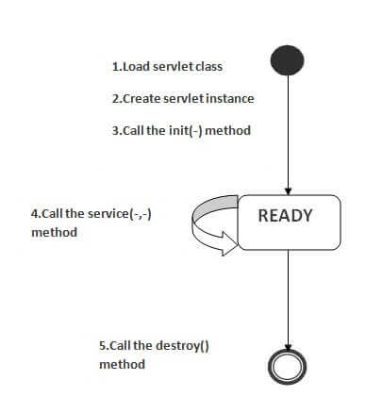
Life Cycle of a Servlet (Servlet Life Cycle)
The web container maintains the life cycle of a servlet instance. Let's see the life cycle of the servlet:
Servlet class is loaded.
Servlet instance is created.
init method is invoked.
service method is invoked.
destroy method is invoked.

Slide 21
Servlet Life Cycle
1) Servlet class is loaded
The classloader is responsible to load the servlet class. The servlet class is loaded when the first request for the servlet is received by the web container.
2) Servlet instance is created
The web container creates the instance of a servlet after loading the servlet class. The servlet instance is created only once in the servlet life cycle.
3) init method is invoked
The web container calls the init method only once after creating the servlet instance. The init method is used to initialize the servlet. It is the life cycle method of the javax.servlet.Servlet interface. Syntax of the init method is given below:
public void init(ServletConfig config) throws ServletException

Slide 22
Servlet Life Cycle
4) service method is invoked
The web container calls the service method each time when request for the servlet is received. If servlet is not initialized, it follows the first three steps as described above then calls the service method. If servlet is initialized, it calls the service method. Notice that servlet is initialized only once. The syntax of the service method of the Servlet interface is given below:
public void service(ServletRequest request, ServletResponse response)
throws ServletException, IOException
5) destroy method is invoked
The web container calls the destroy method before removing the servlet instance from the service. It gives the servlet an opportunity to clean up any resource for example memory, thread etc. The syntax of the destroy method of the Servlet interface is given below:
public void destroy()

Slide 23
Steps to create a servlet example
There are given 6 steps to create a servlet example. These steps are required for all the servers.
The servlet example can be created by three ways:
By implementing Servlet interface,
By inheriting GenericServlet class, (or)
By inheriting HttpServlet class
The mostly used approach is by extending HttpServlet because it provides http request specific method such as doGet(), doPost(), doHead() etc.
Here, we are going to use apache tomcat server in this example.

Slide 24
The steps are as follows:
Create a directory structure
Create a Servlet
Compile the Servlet
Create a deployment descriptor
Start the server and deploy the project
Access the servlet

Slide 25
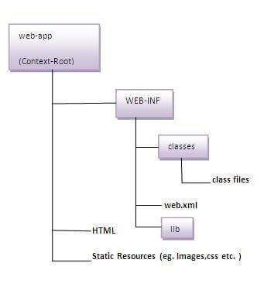
1. Create a directory structures
The directory structure defines that where to put the different types of files so that web container may get the information and respond to the client.
The Sun Microsystem defines a unique standard to be followed by all the server vendors. Let's see the directory structure that must be followed to create the servlet.
the servlet class file must be in the classes folder. The web.xml file must be under the WEB-INF folder.

Slide 26
2. Create a Servlet
There are three ways to create the servlet.
By implementing the Servlet interface
By inheriting the GenericServlet class
By inheriting the HttpServlet class
DemoServlet.java
import javax.servlet.http.*;
import javax.servlet.*;
import java.io.*;
public class DemoServlet extends HttpServlet {
public void doGet(HttpServletRequest req,HttpServletResponse res) throws ServletException,IOException {
res.setContentType("text/html");//setting the content type
PrintWriter pw=res.getWriter();//get the stream to write the data
//writing html in the stream
pw.println("<html><body>");
pw.println("Welcome to servlet");
pw.println("</body></html>");
pw.close();//closing the stream
}
}

Slide 27
3. Compile the servlet
For compiling the Servlet, jar file is required to be loaded. Different Servers provide different jar files:
Two ways to load the jar file
set classpath
paste the jar file in JRE/lib/ext folder
Put the java file in any folder. After compiling the java file, paste the class file of servlet in WEB-INF/classes directory.

Slide 28
4. Create the deployment descriptor (web.xml file)
The deployment descriptor is an xml file, from which Web Container gets the information about the servlet to be invoked.
The web container uses the Parser to get the information from the web.xml file. There are many xml parsers such as SAX, DOM and Pull.
There are many elements in the web.xml file. Here is given some necessary elements to run the simple servlet program.

Slide 29
5. Description of the elements of web.xml file
web.xml file
<web-app>
<servlet>
<servlet-name>Servlet Name</servlet-name>
<servlet-class>DemoServlet</servlet-class>
</servlet>
<servlet-mapping>
<servlet-name>Servlet Namel</servlet-name>
</servlet-mapping>
</web-app>
<web-app> represents the whole application.
<servlet> is sub element of <web-app> and represents the servlet.
<servlet-name> is sub element of <servlet> represents the name of the servlet.
<servlet-class> is sub element of <servlet> represents the class of the servlet.
<servlet-mapping> is sub element of <web-app>. It is used to map the servlet.
<url-pattern> is sub element of <servlet-mapping>. This pattern is used at client side to invoke the servlet.

Slide 30
6. Start the Server and deploy the project
To start Apache Tomcat server, double click on the startup.bat file under apache-tomcat/bin directory.
One Time Configuration for Apache Tomcat Server
You need to perform 2 tasks:
set JAVA_HOME or JRE_HOME in environment variable (It is required to start server).
Change the port number of tomcat (optional). It is required if another server is running on same port (8080).
1) How to set JAVA_HOME in environment variable?
To start Apache Tomcat server JAVA_HOME and JRE_HOME must be set in Environment variables.
Go to My Computer properties -> Click on advanced tab then environment variables -> Click on the new tab of user variable -> Write JAVA_HOME in variable name and paste the path of jdk folder in variable value -> ok -> ok -> ok.

Slide 31
How to access the servlet
http://localhost:8080/demo/welcome

Slide 32
ServletRequest Interface
An object of ServletRequest is used to provide the client request information to a servlet such as content type, content length, parameter names and values, header information, attributes etc.
index.html
<form action="welcome" method="get">
Enter your name<input type="text" name="name"><br>
<input type="submit" value="login">
</form>

Slide 33
Example
welcome.java
import javax.servlet.http.*;
import javax.servlet.*;
import java.io.*;
public class welcome extends HttpServlet {
public void doGet(HttpServletRequest req,HttpServletResponse res) throws ServletException, IOException {
res.setContentType("text/html");
PrintWriter pw=res.getWriter();
String name=req.getParameter("name");//will return value
pw.println("Welcome "+name);
pw.close();
}
}

Slide 34
RequestDispatcher in Servlet
The RequestDispatcher interface provides the facility of dispatching the request to another resource it may be html, servlet or jsp. This interface can also be used to include the content of another resource also. It is one of the way of servlet collaboration.
There are two methods defined in the RequestDispatcher interface.
Methods of RequestDispatcher interface
The RequestDispatcher interface provides two methods. They are:
public void forward(ServletRequest request,ServletResponse response)throws ServletException, IOException: Forwards a request from a servlet to another resource (servlet, JSP file, or HTML file) on the server.
public void include(ServletRequest request,ServletResponse response)throws ServletException, IOException: Includes the content of a resource (servlet, JSP page, or HTML file) in the response.

Slide 35
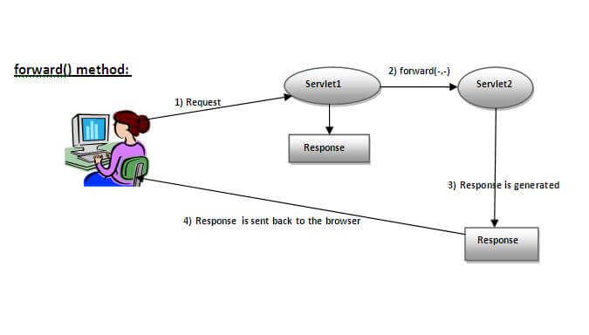
forward method
response of second servlet is sent to the client. Response of the first servlet is not displayed to the user

Slide 36
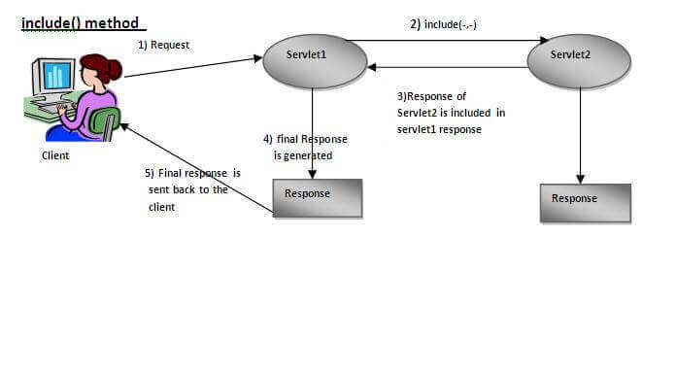
include method
response of second servlet is included in the response of the first servlet that is being sent to the client.

Slide 37
How to get the object of RequestDispatcher
The getRequestDispatcher() method of ServletRequest interface returns the object of RequestDispatcher.
Syntax of getRequestDispatcher method
public RequestDispatcher getRequestDispatcher(String resource);
Example of using getRequestDispatcher method
RequestDispatcher rd=request.getRequestDispatcher("servlet2");
//servlet2 is the url-pattern of the second servlet
rd.forward(request, response);//method may be include or forward

Slide 38
Example of RequestDispatcher interface
In this example, validating the password entered by the user. If password is servlet, it will forward the request to the WelcomeServlet, otherwise will show an error message: sorry username or password error!. In this program, we are checking for hardcoded information.
index.html file: for getting input from the user.
Login.java file: a servlet class for processing the response. If password is servlet, it will forward the request to the welcome servlet.
WelcomeServlet.java file: a servlet class for displaying the welcome message.
web.xml file: a deployment descriptor file that contains the information about the servlet.

Slide 39
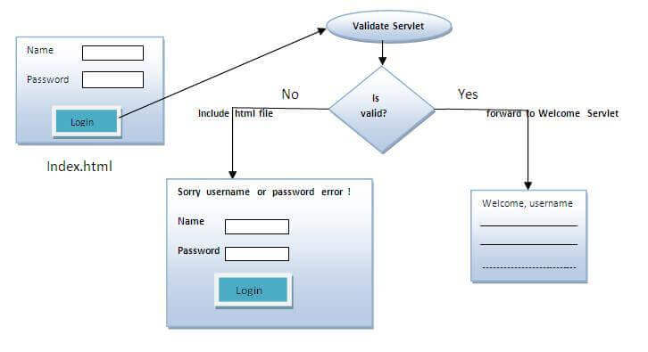
Example

Slide 40
Example
Login.java
import java.io.*;
import javax.servlet.*;
import javax.servlet.http.*;
public class Login extends HttpServlet {
public void doPost(HttpServletRequest request, HttpServletResponse response) throws ServletException, IOException {
response.setContentType("text/html");
PrintWriter out = response.getWriter();
String n=request.getParameter("userName");
String p=request.getParameter("userPass");
if(p.equals("servlet") {
RequestDispatcher rd=request.getRequestDispatcher(“WelcomeServlet");
rd.forward(request, response);
}
else {
out.print("Sorry Password Error!");
RequestDispatcher rd=request.getRequestDispatcher("/index.html");
rd.include(request, response);
}
}
}
index.html
<form action="servlet1" method="post">
Name:<input type="text" name="userName"/><br/>
Password:<input type="password" name="userPass"/><br/>
<input type="submit" value="login"/>
</form>

Slide 41
Example
web.xml
<web-app>
<servlet>
<servlet-name>Login</servlet-name>
<servlet-class>Login</servlet-class>
</servlet>
<servlet>
<servlet-name>WelcomeServlet</servlet-name>
<servlet-class>WelcomeServlet</servlet-class>
</servlet>
<servlet-mapping>
<servlet-name>Login</servlet-name>
<url-pattern>/servlet1</url-pattern>
</servlet-mapping>
<servlet-mapping>
<servlet-name>WelcomeServlet</servlet-name>
<url-pattern>/servlet2</url-pattern>
</servlet-mapping>
<welcome-file-list>
<welcome-file>index.html</welcome-file>
</welcome-file-list>
</web-app>
WelcomeServlet.java
import java.io.*;
import javax.servlet.*;
import javax.servlet.http.*;
public class WelcomeServlet extends HttpServlet {
public void doPost(HttpServletRequest request, HttpServletRespose response)
throws ServletException, IOException {
response.setContentType("text/html");
PrintWriter out = response.getWriter();
String n=request.getParameter("userName");
out.print("Welcome "+n);
}
}

Slide 42
SendRedirect in servlet
The sendRedirect() method of HttpServletResponse interface can be used to redirect response to another resource, it may be servlet, jsp or html file.
It accepts relative as well as absolute URL.
It works at client side because it uses the url bar of the browser to make another request.

Slide 43
Example
DemoServlet.java
import java.io.*;
import javax.servlet.*;
import javax.servlet.http.*;
public class DemoServlet extends HttpServlet{
public void doGet(HttpServletRequest req,HttpServletResponse res
throws ServletException,IOException {
res.setContentType("text/html");
PrintWriter pw=res.getWriter();
response.sendRedirect("http://www.google.com");
pw.close();
}}
Creating custom google search using sendRedirect
In this example, we are using sendRedirect method to send request to google server with the request data.
index.html
<!DOCTYPE html>
<html>
<head>
<meta charset="ISO-8859-1">
<title>sendRedirect example</title>
</head>
<body>
<form action="MySearcher">
<input type="text" name="name">
<input type="submit" value="Google Search">
</form>
</body>
</html>

Slide 44
Example (contd...)
MySearcher.java
import java.io.IOException;
import javax.servlet.ServletException;
import javax.servlet.http.HttpServlet;
import javax.servlet.http.HttpServletRequest;
import javax.servlet.http.HttpServletResponse;
public class MySearcher extends HttpServlet {
protected void doGet(HttpServletRequest request, HttpServletResponse response)
throws ServletException, IOException {
String name=request.getParameter("name");
response.sendRedirect("https://www.google.co.in/#q="+name);
}
}

Slide 45
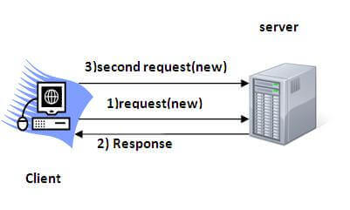
Session Tracking/Session Management
Session - a particular interval of time.
Session Tracking is a way to maintain state (data) of a user.
Http protocol is a stateless, so need to maintain state using session tracking techniques. Each time user requests to the server, server treats the request as the new request. So we need to maintain the state of a user to recognize to particular user.
HTTP is stateless that means each request is considered as the new request. It is shown in the figure given below:
Why use Session Tracking?
To recognize a particular user

Slide 46
Session Tracking Techniques
There are four techniques used in Session tracking:
Cookies
Hidden Form Field
URL Rewriting
HttpSession

Slide 47
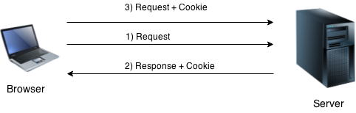
Cookies
A cookie is a small piece of information that is persisted between the multiple client requests.
A cookie has a name, a single value, and optional attributes such as a comment, path and domain qualifiers, a maximum age, and a version number.
How Cookie works?
By default, each request is considered as a new request. In cookies technique, we add cookie with response from the servlet. So cookie is stored in the cache of the browser. After that if request is sent by the user, cookie is added with request by default. Thus, we recognize the user as the old user.

Slide 48
Types of Cookie
There are 2 types of cookies in servlets.
Non-persistent cookie
Persistent cookie
Non-persistent cookie
It is valid for single session only. It is removed each time when user closes the browser.
Persistent cookie
It is valid for multiple sessions. It is not removed each time when user closes the browser. It is removed only if user logout or signout.
Advantage of Cookies
Simplest technique of maintaining the state.
Cookies are maintained at client side.
Disadvantage of Cookies
It will not work, if cookie is disabled from the browser.
Only textual information can be set in Cookie object.

Slide 49
How to create/delete/get/cookie
create cookie.
Cookie ck=new Cookie("user", “Rahul");//creating cookie object
response.addCookie(ck);//adding cookie in the response
delete Cookie
It is mainly used to logout or signout the user.
Cookie ck=new Cookie("user", "");//deleting value of cookie
ck.setMaxAge(0);//changing the maximum age to 0 seconds
get Cookies
to get all the cookies.
Cookie ck[]=request.getCookies();
for(int i=0;i<ck.length;i++){
out.print("<br>"+ck[i].getName()+" "+ck[i].getValue());//printing name and value of cookie
}

Slide 50
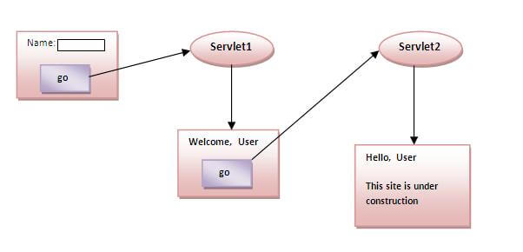
Example
Storing the name of the user in the cookie object and accessing it in another servlet. As we know well that session corresponds to the particular user. So if you access it from too many browsers with different values, you will get the different value.

Slide 51
index.html
<form action="servlet1" method="post">
Name:<input type="text" name="userName"/><br/>
<input type="submit" value="go"/>
</form>

Slide 52
FirstServlet.java
import java.io.*;
import javax.servlet.*;
import javax.servlet.http.*;
public class FirstServlet extends HttpServlet {
public void doPost(HttpServletRequest request, HttpServletResponse response){
try{
response.setContentType("text/html");
PrintWriter out = response.getWriter();
String n=request.getParameter("userName");
out.print("Welcome "+n);
Cookie ck=new Cookie("uname",n);//creating cookie object
response.addCookie(ck);//adding cookie in the response
//creating submit button
out.print("<form action=‘SecondServlet‘ method=‘post’>");
out.print("<input type='submit' value='go'>");
out.print("</form>");
out.close();
}catch(Exception e){System.out.println(e);}
}
}

Slide 53
SecondServlet.java
import java.io.*;
import javax.servlet.*;
import javax.servlet.http.*;
public class SecondServlet extends HttpServlet {
public void doPost(HttpServletRequest request, HttpServletResponse response){
try{
response.setContentType("text/html");
PrintWriter out = response.getWriter();
Cookie ck[]=request.getCookies();
out.print("Hello "+ck[0].getValue());
out.close();
}catch(Exception e){System.out.println(e);}
}
}

Slide 54
web.xml
https://www.javatpoint.com/servlet-login-and-logout-example-using-cookies
<web-app>
<servlet>
<servlet-name>s1</servlet-name>
<servlet-class>FirstServlet</servlet-class>
</servlet>
<servlet-mapping>
<servlet-name>s1</servlet-name>
<url-pattern>/servlet1</url-pattern>
</servlet-mapping>
<servlet>
<servlet-name>s2</servlet-name>
<servlet-class>SecondServlet</servlet-class>
</servlet>
<servlet-mapping>
<servlet-name>s2</servlet-name>
<url-pattern>/servlet2</url-pattern>
</servlet-mapping>
</web-app>

Slide 55
Hidden Form Field
In case of Hidden Form Field a hidden (invisible) textfield is used for maintaining the state of a user.
In such case, we store the information in the hidden field and get it from another servlet. This approach is better if we have to submit form in all the pages and we don't want to depend on the browser.
Let's see the code to store value in hidden field.
<input type="hidden" name="uname" value=“Rahul">
Here, uname is the hidden field name and Rahul is the hidden field value.

Slide 56
Hidden Field
Real application of hidden form field:
It is widely used in comment form of a website. In such case, we store page id or page name in the hidden field so that each page can be uniquely identified.
Advantage of Hidden Form Field:
It will always work whether cookie is disabled or not.
Disadvantage of Hidden Form Field:
It is maintained at server side.
Extra form submission is required on each pages.
Only textual information can be used.

Slide 57
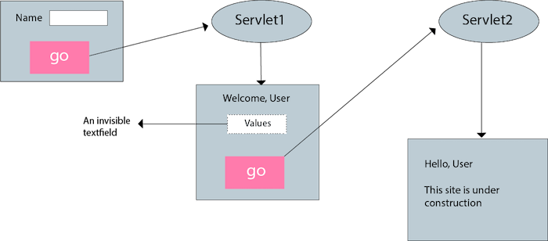
Example of using Hidden Form Field

Slide 58
Example
FirstServlet.java
import java.io.*;
import javax.servlet.*;
import javax.servlet.http.*;
public class FirstServlet extends HttpServlet {
public void doGet(HttpServletRequest request, HttpServletResponse response){
try{
response.setContentType("text/html");
PrintWriter out = response.getWriter();
String n=request.getParameter("userName");
out.print("Welcome "+n);
//creating form that have invisible textfield
out.print("<form action='servlet2'>");
out.print("<input type='hidden' name='uname' value='"+n+"'>");
out.print("<input type='submit' value='go'>");
out.print("</form>");
out.close();
}catch(Exception e){System.out.println(e);}
}
}
index.html
<form action="servlet1">
Name:<input type="text" name="userName"/><br/>
<input type="submit" value="go"/>
</form>

Slide 59
Example
web.xml
<web-app>
<servlet>
<servlet-name>s1</servlet-name>
<servlet-class>FirstServlet</servlet-class>
</servlet>
<servlet-mapping>
<servlet-name>s1</servlet-name>
<url-pattern>/servlet1</url-pattern>
</servlet-mapping>
<servlet>
<servlet-name>s2</servlet-name>
<servlet-class>SecondServlet</servlet-class>
</servlet>
<servlet-mapping>
<servlet-name>s2</servlet-name>
<url-pattern>/servlet2</url-pattern>
</servlet-mapping>
</web-app>
SecondServlet.java
import java.io.*;
import javax.servlet.*;
import javax.servlet.http.*;
public class SecondServlet extends HttpServlet {
public void doGet(HttpServletRequest request, HttpServletResponse response)
try{
response.setContentType("text/html");
PrintWriter out = response.getWriter();
//Getting the value from the hidden field
String n=request.getParameter("uname");
out.print("Hello "+n);
out.close();
}catch(Exception e){System.out.println(e);}
}
}

Slide 60
URL rewriting
URL rewriting, we append a token or identifier to the URL of the next Servlet or the next resource. We can send parameter name/value pairs using the following format:
url?name1=value1&name2=value2&??
A name and a value is separated using an equal = sign, a parameter name/value pair is separated from another parameter using the ampersand(&).
Advantage of URL Rewriting
It will always work whether cookie is disabled or not.
Extra form submission is not required on each pages.
Disadvantage of URL Rewriting
It will work only with links.
It can send Only textual information.

Slide 61
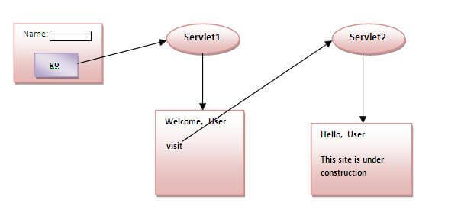
Example

Slide 62
Example
index.html
<form action="servlet1">
Name:<input type="text" name="userName"/><br/>
<input type="submit" value="go"/>
</form>
FirstServlet.java
import java.io.*;
import javax.servlet.*;
import javax.servlet.http.*;
public class FirstServlet extends HttpServlet {
public void doGet(HttpServletRequest request, HttpServletResponse response){
try{
response.setContentType("text/html");
PrintWriter out = response.getWriter();
String n=request.getParameter("userName");
out.print("Welcome "+n);
//appending the username in the query string
out.print("<a href='servlet2?uname="+n+"'>visit</a>");
out.close();
}catch(Exception e){System.out.println(e);}
}
}

Slide 63
Example
web.xml
<web-app> <servlet>
<servlet-name>s1</servlet-name>
<servlet-class>FirstServlet</servlet-class>
</servlet>
<servlet-mapping>
<servlet-name>s1</servlet-name>
<url-pattern>/servlet1</url-pattern>
</servlet-mapping>
<servlet>
<servlet-name>s2</servlet-name>
<servlet-class>SecondServlet</servlet-class>
</servlet>
<servlet-mapping>
<servlet-name>s2</servlet-name>
<url-pattern>/servlet2</url-pattern>
</servlet-mapping>
</web-app>
SecondServlet.java
import java.io.*;
import javax.servlet.*;
import javax.servlet.http.*;
public class SecondServlet extends HttpServlet {
public void doGet(HttpServletRequest request, HttpServletResponse response)
try{
response.setContentType("text/html");
PrintWriter out = response.getWriter();
//getting value from the query string
String n=request.getParameter("uname");
out.print("Hello "+n);
out.close();
}catch(Exception e){System.out.println(e);}
}
}

Slide 64
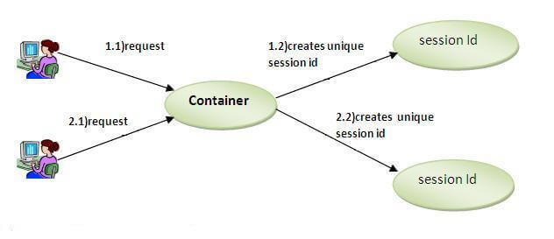
HttpSession interface
In such case, container creates a session id for each user. The container uses this id to identify the particular user. An object of HttpSession can be used to perform two tasks:
bind objects
view and manipulate information about a session, such as the session identifier, creation time, and last accessed time.

Slide 65
HttpSession
How to get the HttpSession object ?
The HttpServletRequest interface provides two methods to get the object of HttpSession:
public HttpSession getSession():Returns the current session associated with this request, or if the request does not have a session, creates one.
public HttpSession getSession(boolean create):Returns the current HttpSession associated with this request or, if there is no current session and create is true, returns a new session.
Commonly used methods of HttpSession interface
public String getId():Returns a string containing the unique identifier value.
public long getCreationTime():Returns the time when this session was created, measured in milliseconds since midnight January 1, 1970 GMT.
public long getLastAccessedTime():Returns the last time the client sent a request associated with this session, as the number of milliseconds since midnight January 1, 1970 GMT.
public void invalidate():Invalidates this session then unbinds any objects bound to it.

Slide 66
Example of using HttpSession
index.html
<form action="servlet1">
Name:<input type="text" name="userName"/><br/>
<input type="submit" value="go"/>
</form>
FirstServlet.java
import java.io.*;
import javax.servlet.*;
import javax.servlet.http.*;
public class FirstServlet extends HttpServlet {
public void doGet(HttpServletRequest request, HttpServletResponse response){
try{
response.setContentType("text/html");
PrintWriter out = response.getWriter();
String n=request.getParameter("userName");
out.print("Welcome "+n);
HttpSession session=request.getSession();
session.setAttribute("uname",n);
out.print("<a href='servlet2'>visit</a>");
out.close();
}catch(Exception e){System.out.println(e);}
}
}

Slide 67
Example of using HttpSession (contd...)
//SecondServlet.java
import java.io.*;
import javax.servlet.*;
import javax.servlet.http.*;
public class SecondServlet extends HttpServlet {
public void doGet(HttpServletRequest request, HttpServletResponse response)
try{
response.setContentType("text/html");
PrintWriter out = response.getWriter();
HttpSession session=request.getSession(false);
String n=(String)session.getAttribute("uname");
out.print("Hello "+n);
out.close();
}catch(Exception e){System.out.println(e);}
}
}
web.xml
<web-app>
<servlet>
<servlet-name>s1</servlet-name>
<servlet-class>FirstServlet</servlet-class>
</servlet>
<servlet-mapping>
<servlet-name>s1</servlet-name>
<url-pattern>/servlet1</url-pattern>
</servlet-mapping>
<servlet>
<servlet-name>s2</servlet-name>
<servlet-class>SecondServlet</servlet-class>
</servlet>
<servlet-mapping>
<servlet-name>s2</servlet-name>
<url-pattern>/servlet2</url-pattern>
</servlet-mapping>
</web-app>

